Slide 1
AI-Driven Threat Detection with MITRE ATT&CK Mapping Report
CSCI_7783 Information Security
Guanhua Zhao，Honghao Yu， Hongxia Zhou，Ming Zhao
July 19, 2025

Slide 2
BaseLine GPU-Accelerated Network Threat Detection
Objective: Detect multiple types of cyber-attacks from network flow data
Tools: cuML, Logistic Regression, StandardScaler
Pipeline: Data Integration → Preprocessing → Modeling → Evaluation

Slide 3
Dataset Overview and Feature Engineering
8 CSV files combined: 2,830,743 records
Initial features: 79 columns → final 76 numerical features
Removed: Flow ID, Source/Destination IPs, Timestamps
NaNs and ±Inf replaced with 0
Feature scaling: StandardScaler (without mean centering)

Slide 4
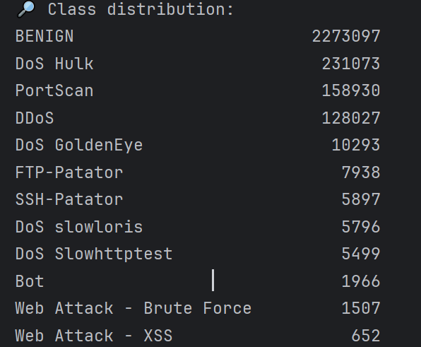
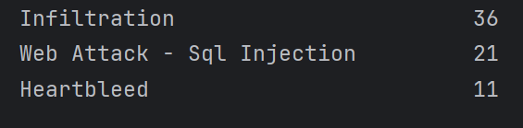
Severe Data Imbalance
BENIGN: ~80% of all records
Rare classes like Heartbleed: only ~10 samples
Visualization: Bar chart showing label distribution
Challenge: Skewed gradient updates favor majority class

Slide 5
Baseline Model: Logistic Regression
Framework: cuML (GPU-accelerated)
Solver: Quasi-Newton (QN)
Regularization: L2, C=1.0
Max Iterations: 2000
Training time: < 1 minute
Warning: 700 MB host-to-device memory pressure

Slide 6
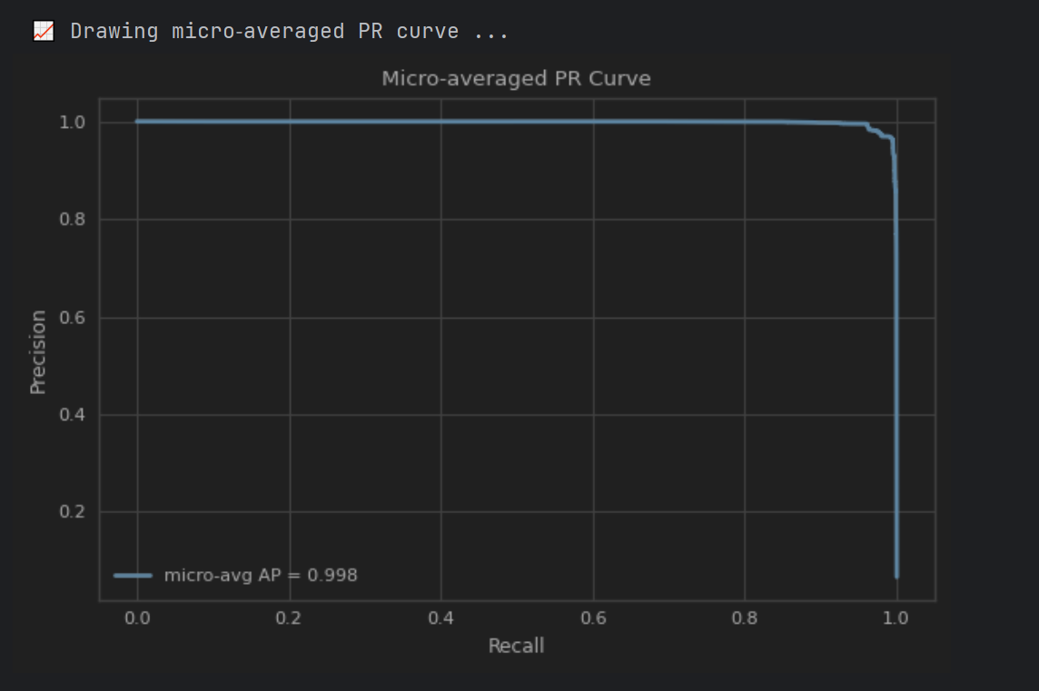
Model Performance Overview
Accuracy: 97.69%
Micro-averaged Average Precision (AP): 0.998
PR Curve: Near top-left corner → stable predictions

Slide 7
Precision & Recall per Class
BENIGN, DDoS, PortScan: >95% Precision & Recall
Bot: Recall only 2%
DoS slowloris: Recall 56%
Web-Attack & Infiltration: ~0% Recall
Visual: Precision/Recall bar chart by class

Slide 8
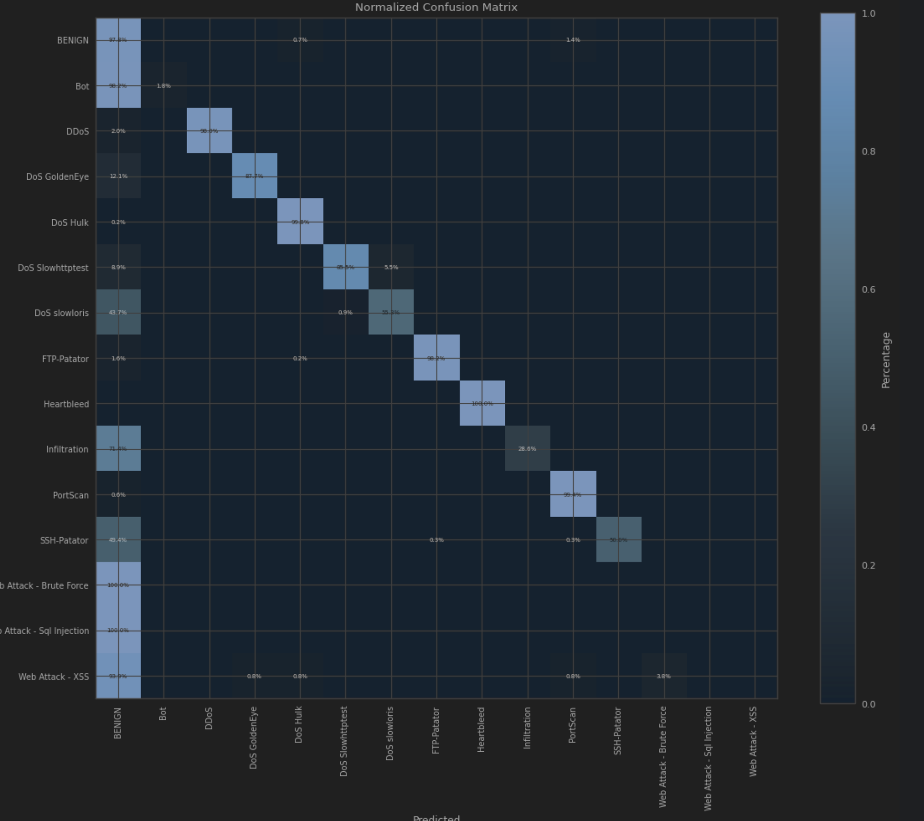
Misclassification Patterns
Many rare classes misclassified as BENIGN or DoS
Confirms linear model limitations under imbalance
Visual: Normalized confusion matrix

Slide 9
Challenges and Optimization Directions
Root Causes:
Extreme imbalance
Linear model capacity
Lack of contextual/temporal features
Recommendations:
SMOTE oversampling for rare classes
Hierarchical classification: benign vs attack first
Stratified sampling for balanced training subsets

Slide 10
Stratified Sampling – Comparative Analysis
GPU Logistic Regression for Intrusion Detection

Slide 11
Introduction
Baseline: cuML's Logistic Regression
Issue: poor performance for minority classes
Solution: StratifiedShuffleSplit for balanced training sets

Slide 12
Optimization Method
Ensures all classes, especially minorities, are represented
Improves model visibility and generalization

Slide 13
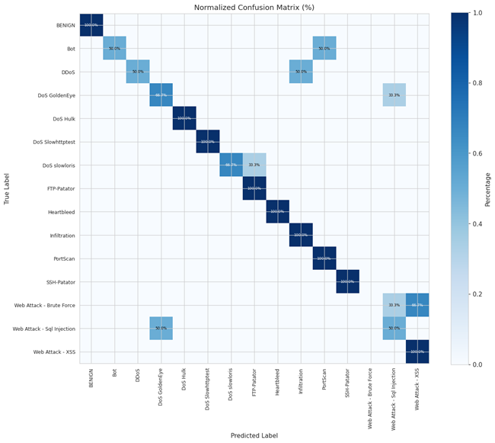
Advantages Over Baseline
Balanced class representation
WebAttack recall ↑ from ~10% to 46%
Accuracy ↑ by ~4.6%
More stable PR curves and confusion matrix

Slide 14
Remaining Deficiencies
No change in core algorithm (LogReg)
Lacks dynamic/temporal features
Still depends on minimal class distribution
Limited capability in complex attack scenarios

Slide 15
Future Work & Summary Insights
Next steps:
Add time-series features
Try stronger models (e.g., Transformer)
Handle imbalance with SMOTE or cost-sensitive learning
Stratified sampling improves detection of rare attacks
No change to model structure required

Slide 16
Hierarchical GPU Logistic Regression

Slide 17
Objective: Build a GPU-accelerated logistic regression model for multi-class intrusion detection.
Issue: Extreme class imbalance in real-world datasets leads to poor detection of rare attacks.
Examples: Heartbleed, Bot, and Web-Attack are nearly undetectable by vanilla models.
Solution: Use a hierarchical structure to better capture minority class signals.

Slide 18
Two-Stage Model Architecture
Stage 1: Binary classification to detect if traffic is BENIGN or ATTACK.
Stage 2: Multi-class classification to identify specific attack type (14 total classes).
Benefits: Reduces interference from normal traffic and enhances detection of rare attacks.This coarse-to-fine approach enables better gradient signals for model learning.

Slide 19
Data Processing & Sampling Strategy
Process 500,000 rows per batch to optimize GPU memory usage.Downsample BENIGN samples to achieve initial 1:1 class balance.
Apply class-wise sampling:
- Oversample if samples < 1,000 (upsample_minority())
- Downsample if samples > 3,000 or 20x other classes (auto_downsample())These steps improve training balance and mitigate learning bias.

Slide 20
Model Configuration and Prediction Workflow
Use cuML's LogisticRegression with GPU acceleration.
Settings: QN (Quasi-Newton) optimizer, L2 regularization, max iterations = 1200.
Stage 1: Predict BENIGN vs ATTACK for all data.
Stage 2: Further classify ATTACK samples into specific attack types.
Final outputs: classification report and confusion matrix.

Slide 21
Performance Analysis & Limitations
Accuracy improved from 76% to 83.2% compared to vanilla model.
Significant recall gain for rare attacks: Heartbleed (57.8%), Bot (36%).
"Sacrificing global for local" boosts rare threat detection.
Challenges:
- Increased complexity due to two-stage design.
- Oversampling may lead to overfitting or false positives.
- Sensitive to data distribution and class balancing.
Limitations:
- Lacks temporal/session-based features.
- Logistic regression is linear and misses high-order patterns.
Future plan: apply SMOTE for better minority class handling.

Slide 22
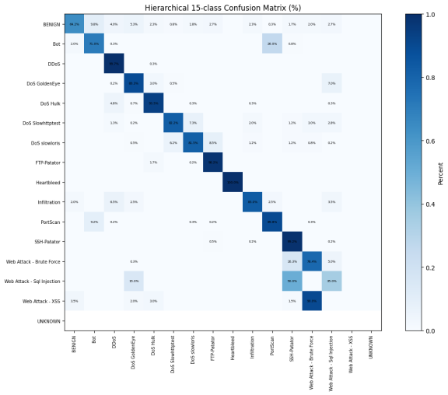
Analysis of 15-Class Confusion Matrix
The figure shows the classification accuracy for each type of attack.
The detection rates for rare attacks such as Heartbleed and Bot have improved significantly, and the concentration of misclassifications has noticeably decreased.

Slide 23
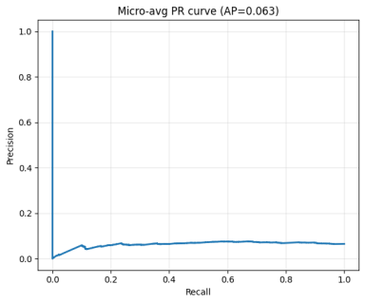
Micro-Averaged Precision-Recall (PR) Curve

Slide 24
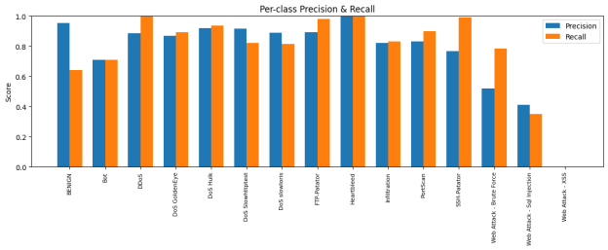
This figure shows that the model maintains high precision and recall across most categories, with particularly significant improvements for attacks such as Heartbleed and Brute Force.
Precision / Recall Comparison Across Classes

Slide 25
SMOTE
Model: Logistic Regression (QN) + SMOTE Strategy

Slide 26
Model Selection:
-cuML.LogisticRegression with one-vs-rest for multi-class classification.
-Provides high interpretability
-Compatible with flexible sampling strategies like SMOTE.
Training Task:
-16-class classification (15 attacks + BENIGN)
-Supports metrics: AP, Precision, Recall, Confusion Matrix.

Slide 27
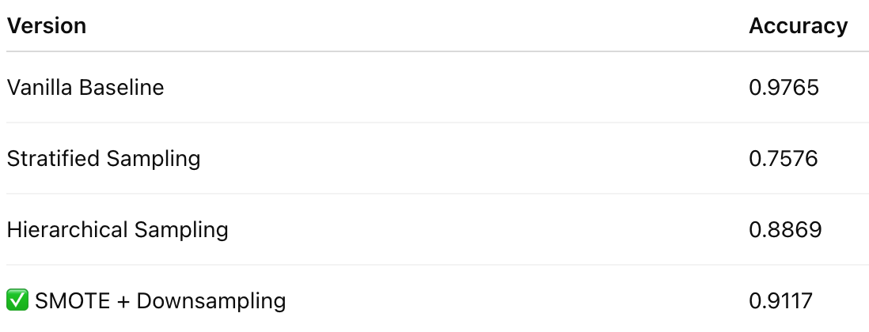
Model Performance Comparison

Slide 28
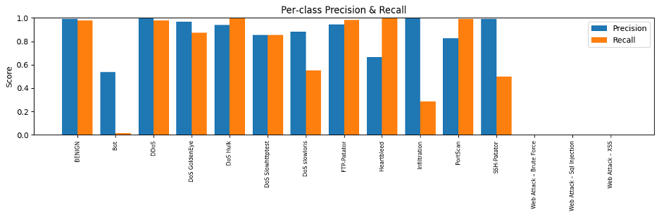
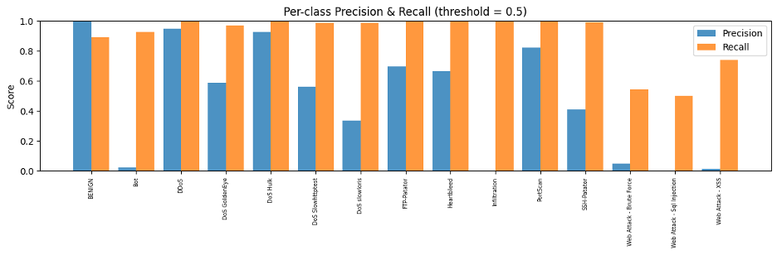
Visualization Results - Per-class precision/recall

Slide 29
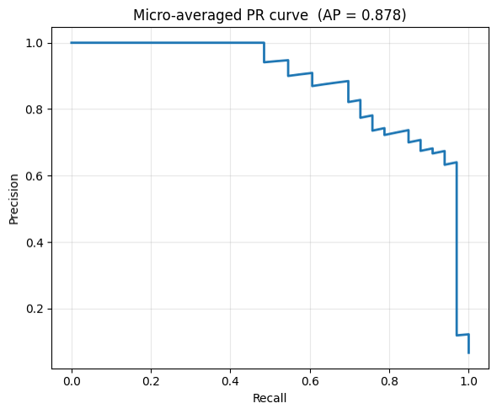
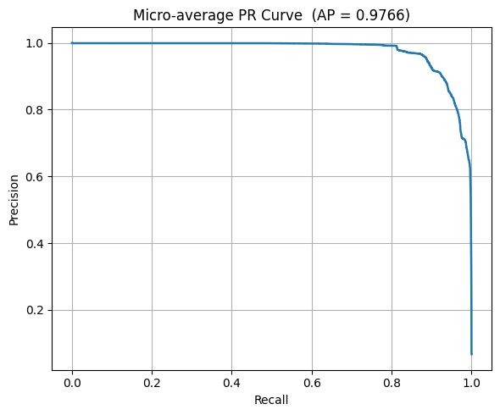
Visualization Results - Per-class precision/recall

Slide 30
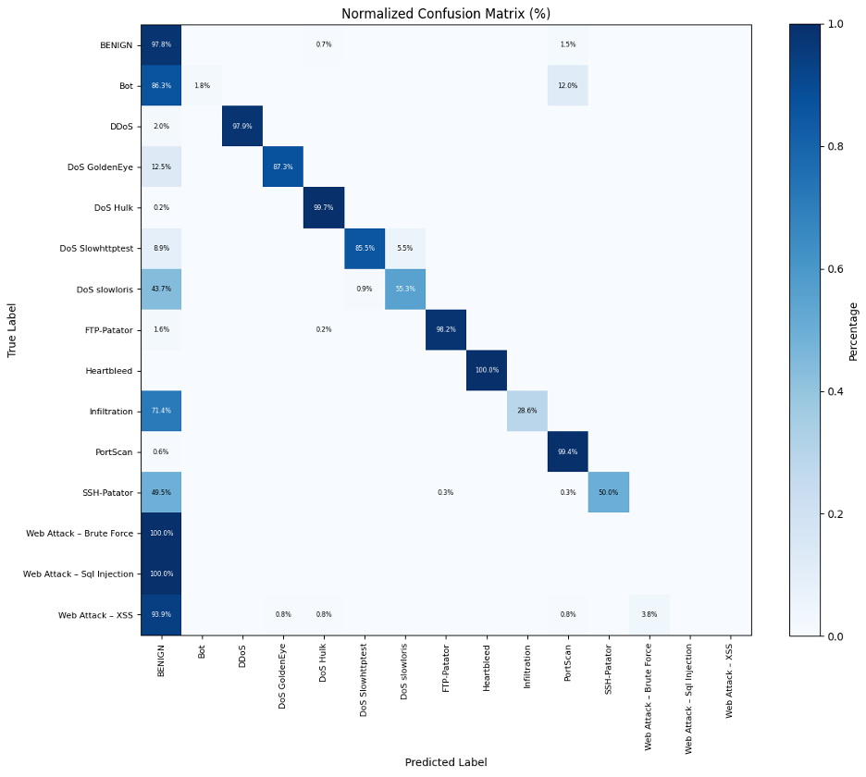
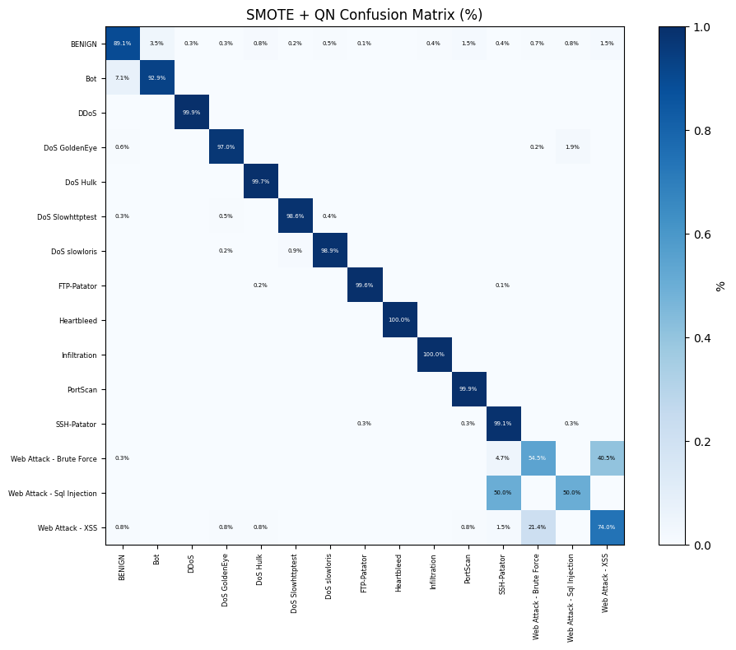
Visualization Results - Per-class precision/recall

Slide 31
Thank you !

